Slide 1
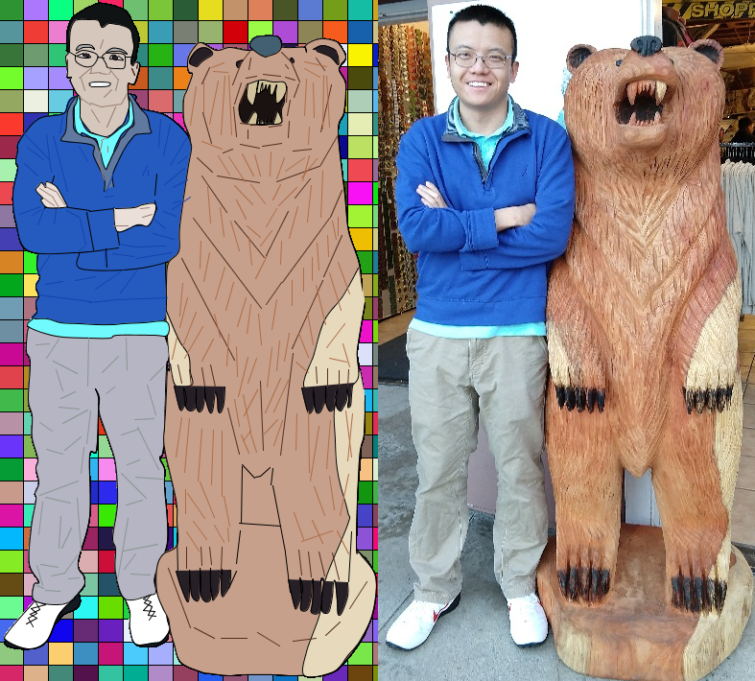
Yao Yao

Slide 2
PImage img;
int p = 0, q = 0;
PFont f;
void settings() {
img = loadImage("1.jpg");
int iWidth = img.width*2;
int iHeight = img.height;
size(iWidth, iHeight);
}
void setup() {
f = createFont("Arial",8,true);
}
void mousePressed() {
if(mouseButton == RIGHT) {
save("final.jpg");
}
}
void keyPressed() {
if (key == CODED) {
float x = img.width*pow(1.1,p)/15;
float y = img.height*pow(1.1,p)/30;
stroke(1);
for(int i = 0; i < img.width; i += x){
for(int j = 0; j < img.height; j += y){
fill(int(random(255)),int(random(255)),int(random(255)));
rect(i,j,x,y);
}
}
if (keyCode == UP) { //size
p++;
} else if (keyCode == DOWN) {
p--;
} else if (keyCode == RIGHT) { //position
q+=10;
} else if (keyCode == LEFT) {
q-=10;
}
}
}
void draw() {
textFont(f,16);
fill(255);
text("Press: Left, Right, Up, or Down",0,16);
float iWidth = img.width*pow(1.1,p);
float iHeight = img.height*pow(1.1,p);
image(img, img.width, 0);
stroke(1);
fill(19,26,34); // black shoes
beginShape();
curveVertex(0.333333333*iWidth+q,0.864640884*iHeight);
curveVertex(0.333333333*iWidth+q,0.864640884*iHeight);
curveVertex(0.345959596*iWidth+q,0.883977901*iHeight);
curveVertex(0.348484848*iWidth+q,0.904696133*iHeight);
curveVertex(0.356060606*iWidth+q,0.92679558*iHeight);
curveVertex(0.371212121*iWidth+q,0.933701657*iHeight);
curveVertex(0.404040404*iWidth+q,0.935082873*iHeight);
curveVertex(0.421717172*iWidth+q,0.932320442*iHeight);
curveVertex(0.444444444*iWidth+q,0.924033149*iHeight);
curveVertex(0.446969697*iWidth+q,0.910220994*iHeight);
curveVertex(0.449494949*iWidth+q,0.901933702*iHeight);
curveVertex(0.441919192*iWidth+q,0.890883978*iHeight);
curveVertex(0.434343434*iWidth+q,0.88121547*iHeight);
curveVertex(0.426767677*iWidth+q,0.870165746*iHeight);
curveVertex(0.419191919*iWidth+q,0.860497238*iHeight);
curveVertex(0.419191919*iWidth+q,0.860497238*iHeight);
endShape(CLOSE);
Draw Code

Slide 3
Using Processing's 2D drawing functions, create a self-portrait. Structure your code so that changing a size or position variable updates the entire portrait. Please be prepared to discuss how the algorithmic/coding process impacted the finished piece as compared to drawing, painting, or photographing a self-portrait.
In regards to changing a size or position, the frame width and height changes with the original picture size
void settings() {
img = loadImage("1.jpg");
int iWidth = img.width*2;
int iHeight = img.height;
size(iWidth, iHeight);
}
All shapes and lines formed change in regards to the original height and width of the picture and adapts to the original dimensions.
void keyPressed() {
if (key == CODED) {
float x = img.width*pow(1.1,p)/15;
float y = img.height*pow(1.1,p)/30;
stroke(1);
for(int i = 0; i < img.width; i += x){
for(int j = 0; j < img.height; j += y){
fill(int(random(255)),int(random(255)),int(random(255)));
rect(i,j,x,y);
}
}
if (keyCode == UP) { //size
p++;
} else if (keyCode == DOWN) {
p--;
} else if (keyCode == RIGHT) { //position
q+=10;
} else if (keyCode == LEFT) {
q-=10;
}
}
}
void draw() {
textFont(f,16);
fill(255);
text("Press: Left, Right, Up, or Down",0,16);
float iWidth = img.width*pow(1.1,p);
float iHeight = img.height*pow(1.1,p);
image(img, img.width, 0);
stroke(1);
fill(19,26,34); // black shoes
beginShape();
curveVertex(0.333333333*iWidth+q,0.864640884*iHeight);
curveVertex(0.333333333*iWidth+q,0.864640884*iHeight);

Slide 4
PImage myBackground;
ArrayList<PVector> points = new ArrayList<PVector>();
int l =3; //manual change
void settings() {
myBackground = loadImage("1.jpg");
int myWidth = myBackground.width;
int myHeight = myBackground.height;
size(myWidth, myHeight);
}
void draw() {
background(myBackground);
if(l == 1){ //curveVertex
beginShape();
for(int i = 0; i < points.size(); i++) {
if(i == 0 || i == points.size() - 1) {
curveVertex(int(points.get(i).x), int(points.get(i).y));
}
curveVertex(int(points.get(i).x), int(points.get(i).y));
}
endShape();
} else if(l == 2){ //curve
if(points.size() != 0 && points.size() % 4 == 0){
for(int i = 0; i < points.size()-3; i+=4){
curve(int(points.get(i+2).x), int(points.get(i+2).y), int(points.get(i).x), int(points.get(i).y),
int(points.get(i+1).x), int(points.get(i+1).y),int(points.get(i+3).x), int(points.get(i+3).y));
}
}
} else if(l == 3){ //lines connected
for(int i = 0; i < points.size()-1; i+=1){
line(int(points.get(i).x),int(points.get(i).y),int(points.get(i+1).x),int(points.get(i+1).y));
}
} else if(l == 4){ //lines discrete
for(int i = 0; i < points.size()-1; i+=2){
line(int(points.get(i).x),int(points.get(i).y),int(points.get(i+1).x),int(points.get(i+1).y));
}
}
}
void mousePressed() {
if (mouseButton == LEFT) {
points.add(new PVector(mouseX, mouseY));
} else if(mouseButton == RIGHT) { //get fill color
color c = get(mouseX, mouseY);
println("fill(" + int(red(c)) + "," + int(green(c)) + "," + int(blue(c)) + ");");
}
}
void keyPressed() {
if(key == ' ') { //curveVertex
l=1;
println("beginShape();");
println("curveVertex(" + int(points.get(0).x) + ", " + int(points.get(0).y) + ");");
for(int i = 0; i < points.size(); i++) {
println("curveVertex(" + int(points.get(i).x) + ", " + int(points.get(i).y) + ");");
}
println("curveVertex(" + int(points.get(points.size()-1).x) + ", " + int(points.get(points.size()-1).y) + ");");
println("endShape();");
}
if(key == '2') { //curve
l=2;
for(int i = 0; i < points.size()-3; i+=4){
println("curve("+ int(points.get(i+2).x) + ","+ int(points.get(i+2).y) + ","+
int(points.get(i).x) + ","+ int(points.get(i).y) + ","+ int(points.get(i+1).x) + ","+
int(points.get(i+1).y) + ","+ + int(points.get(i+3).x) + ","+ int(points.get(i+3).y) + ");");
}
}
if(key == '3') { //lines connected
l=3;
for(int i = 0; i < points.size()-1; i+=1){
println("line("+int(points.get(i).x) + ","+ int(points.get(i).y) + ","+
int(points.get(i+1).x) + ","+ int(points.get(i+1).y) + ");");
}
}
if(key == '4') { //lines discrete
l=4;
for(int i = 0; i < points.size()-1; i+=2){
println("line("+int(points.get(i).x) + ","+ int(points.get(i).y) + ","+
int(points.get(i+1).x) + ","+ int(points.get(i+1).y) + ");");
}
}
}
The tool that I
Wrote to create
The drawing

